Slide 1
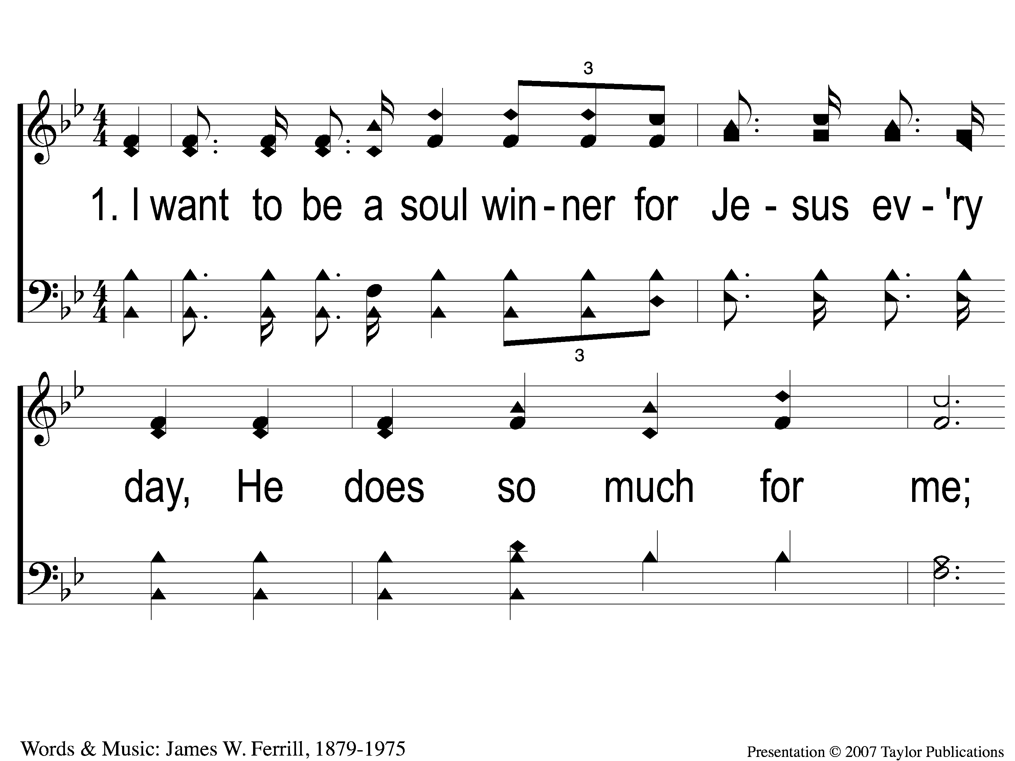
1-1 A Soul Winner For Jesus
A Soul Winner For Jesus
18

Slide 2
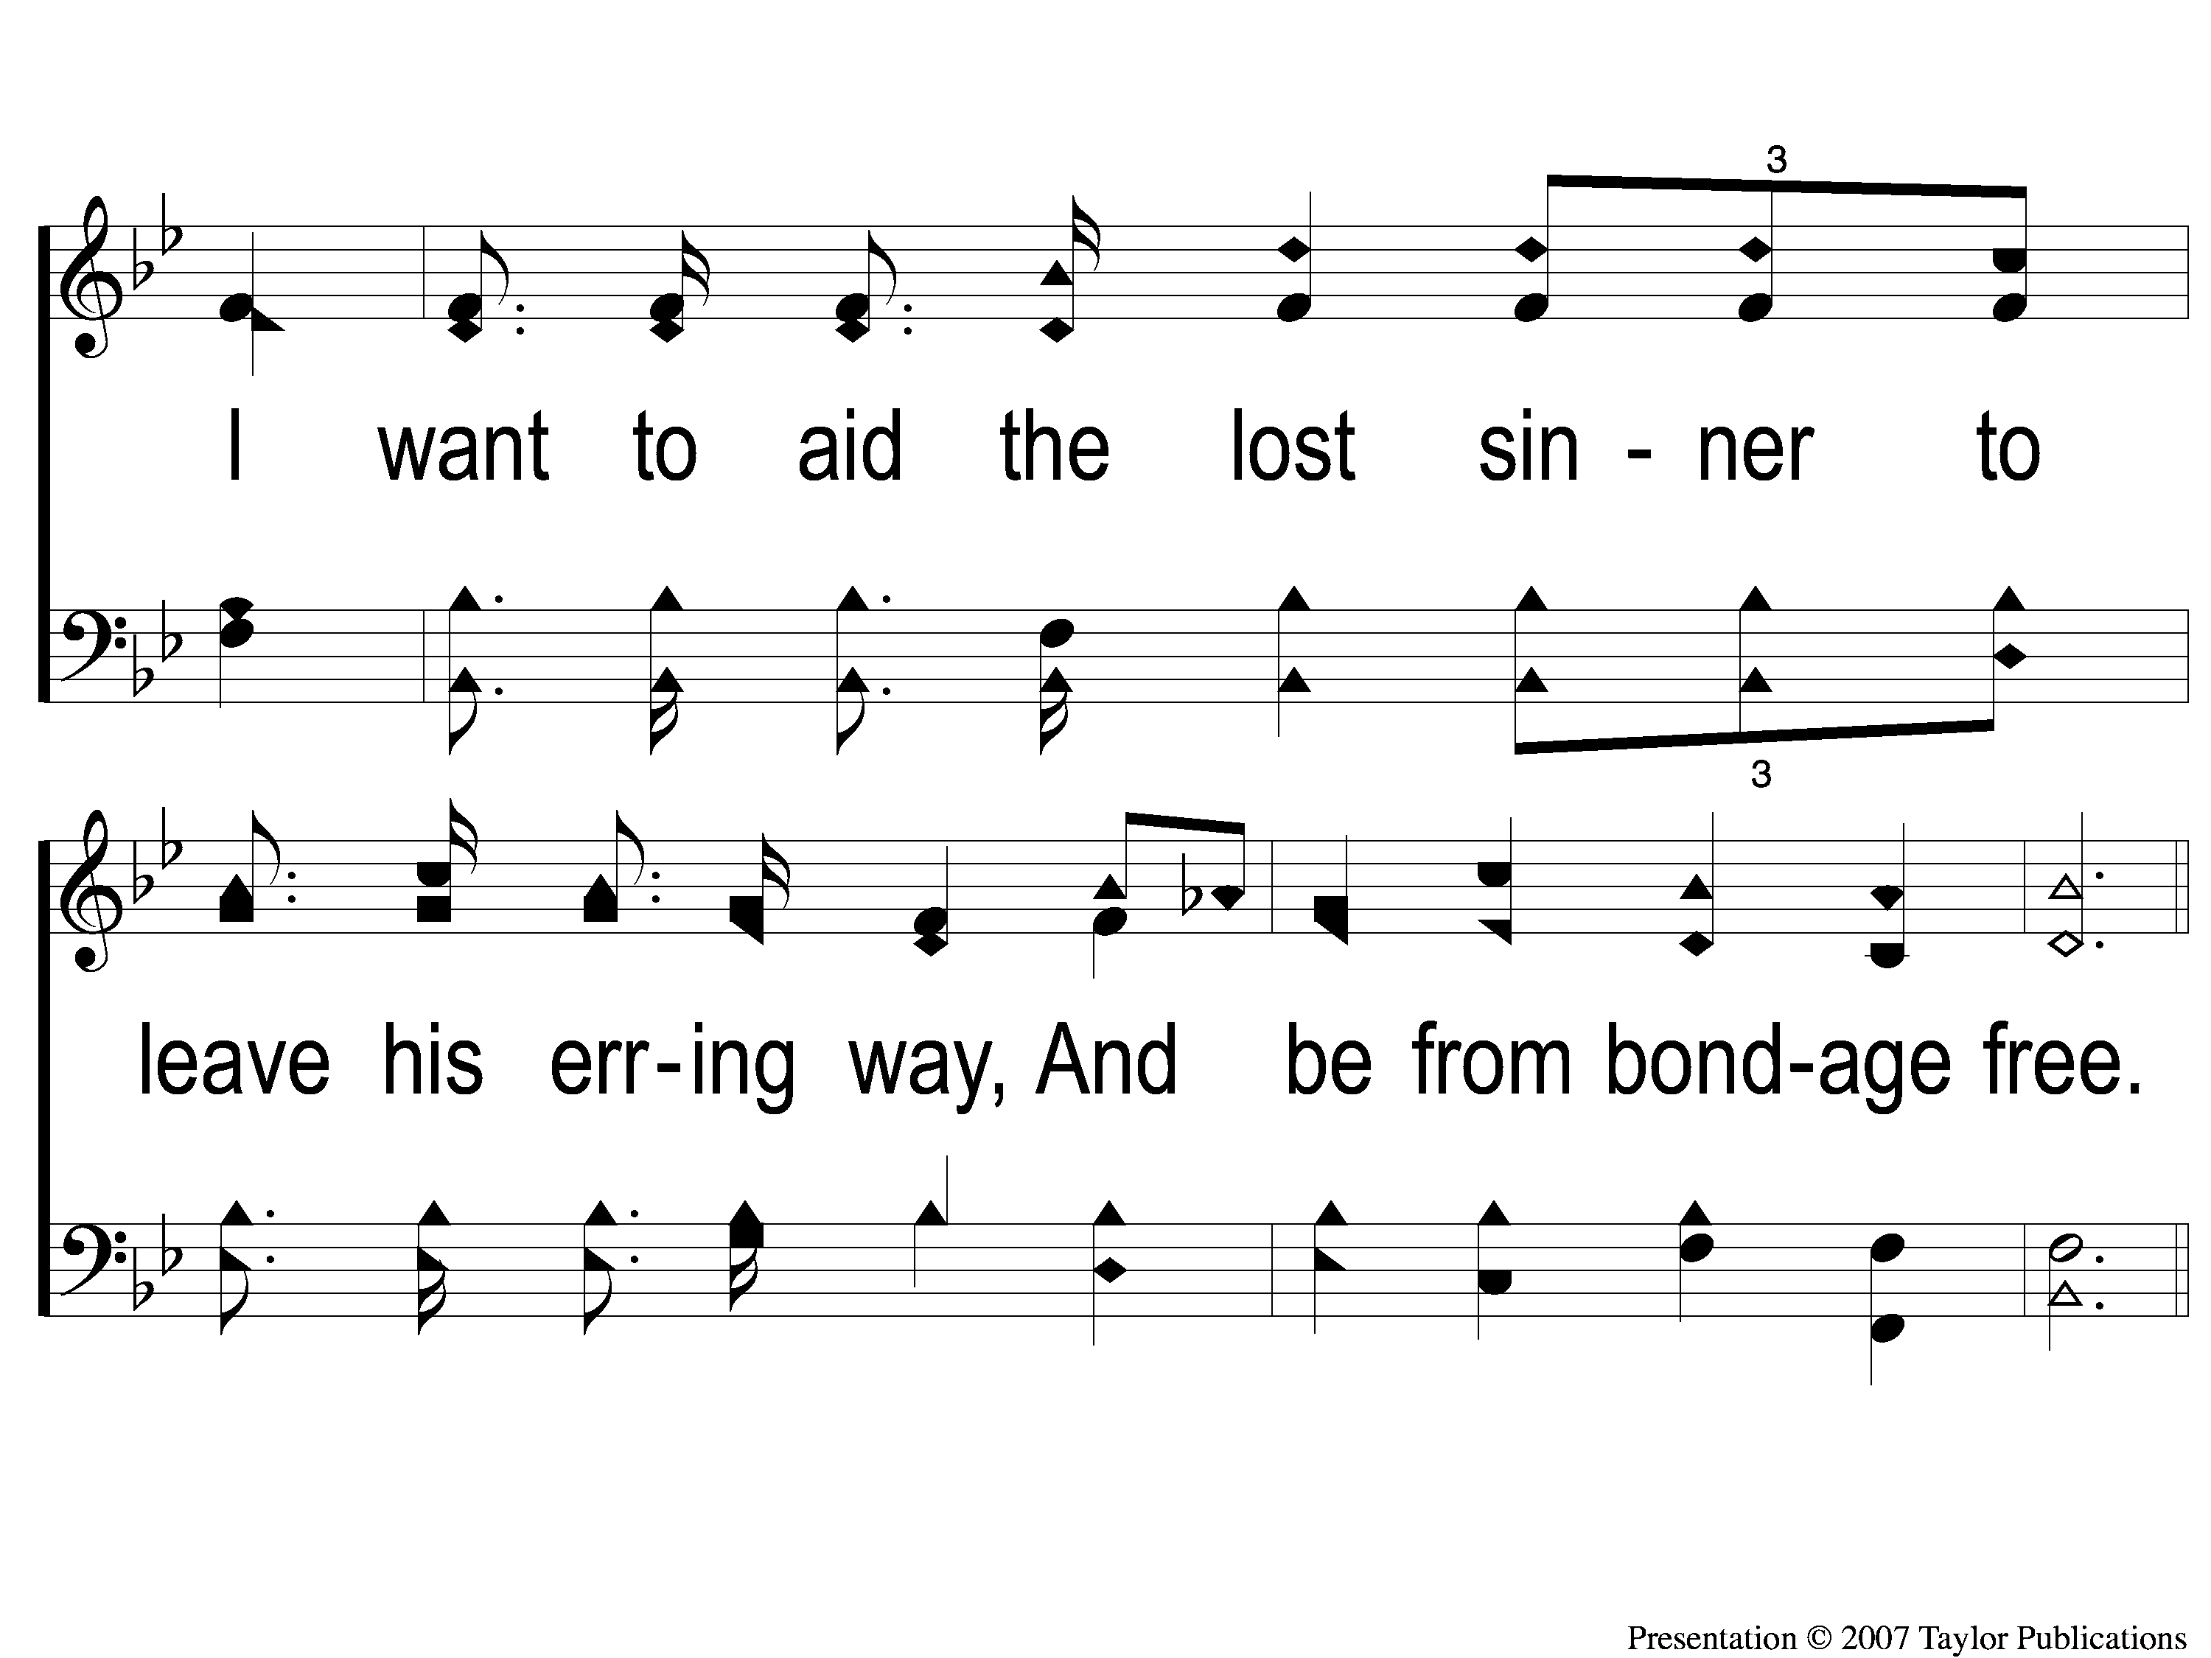
1-2 A Soul Winner For Jesus
A Soul Winner For Jesus
18

Slide 3
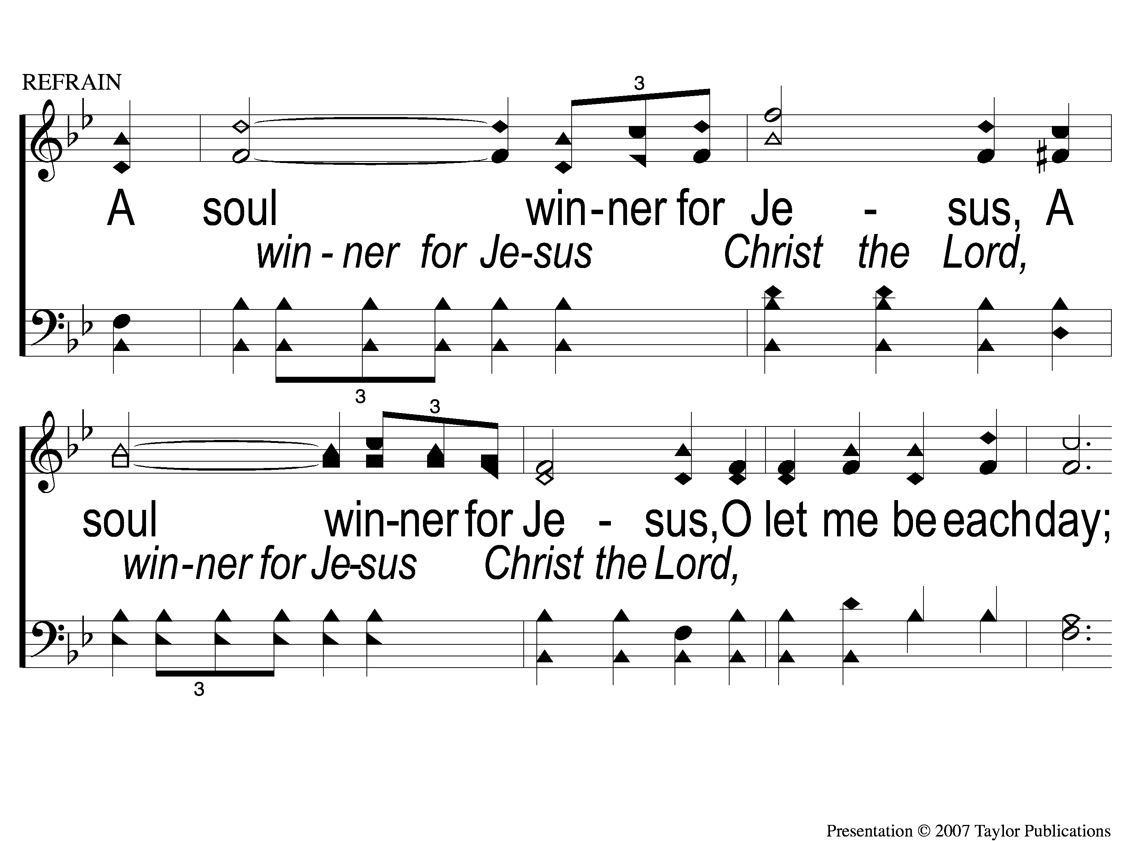
C-1 A Soul Winner For Jesus
A Soul Winner For Jesus
18

Slide 4
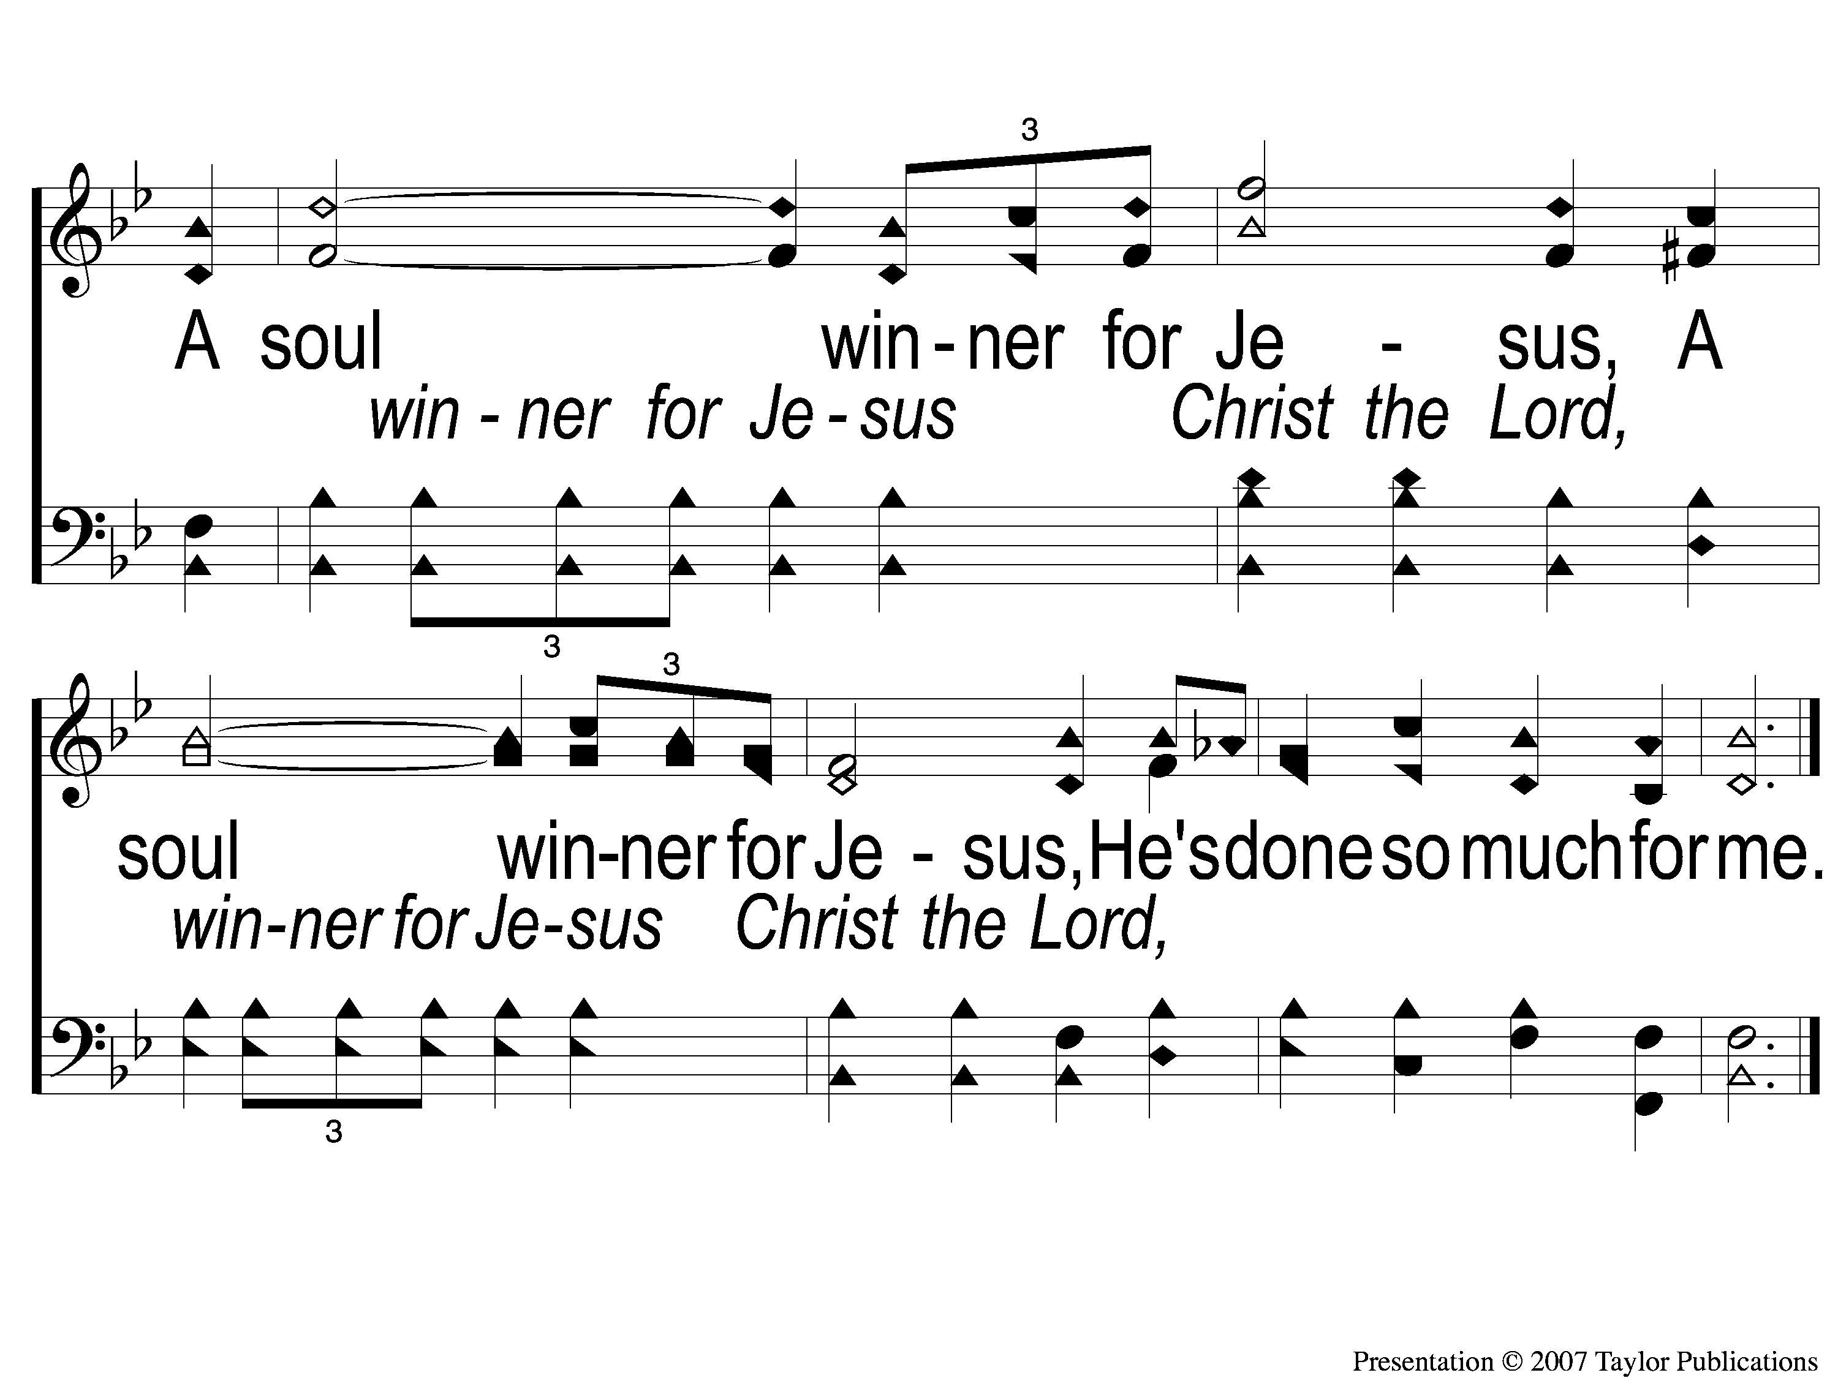
C-2 A Soul Winner For Jesus
A Soul Winner For Jesus
18

Slide 5
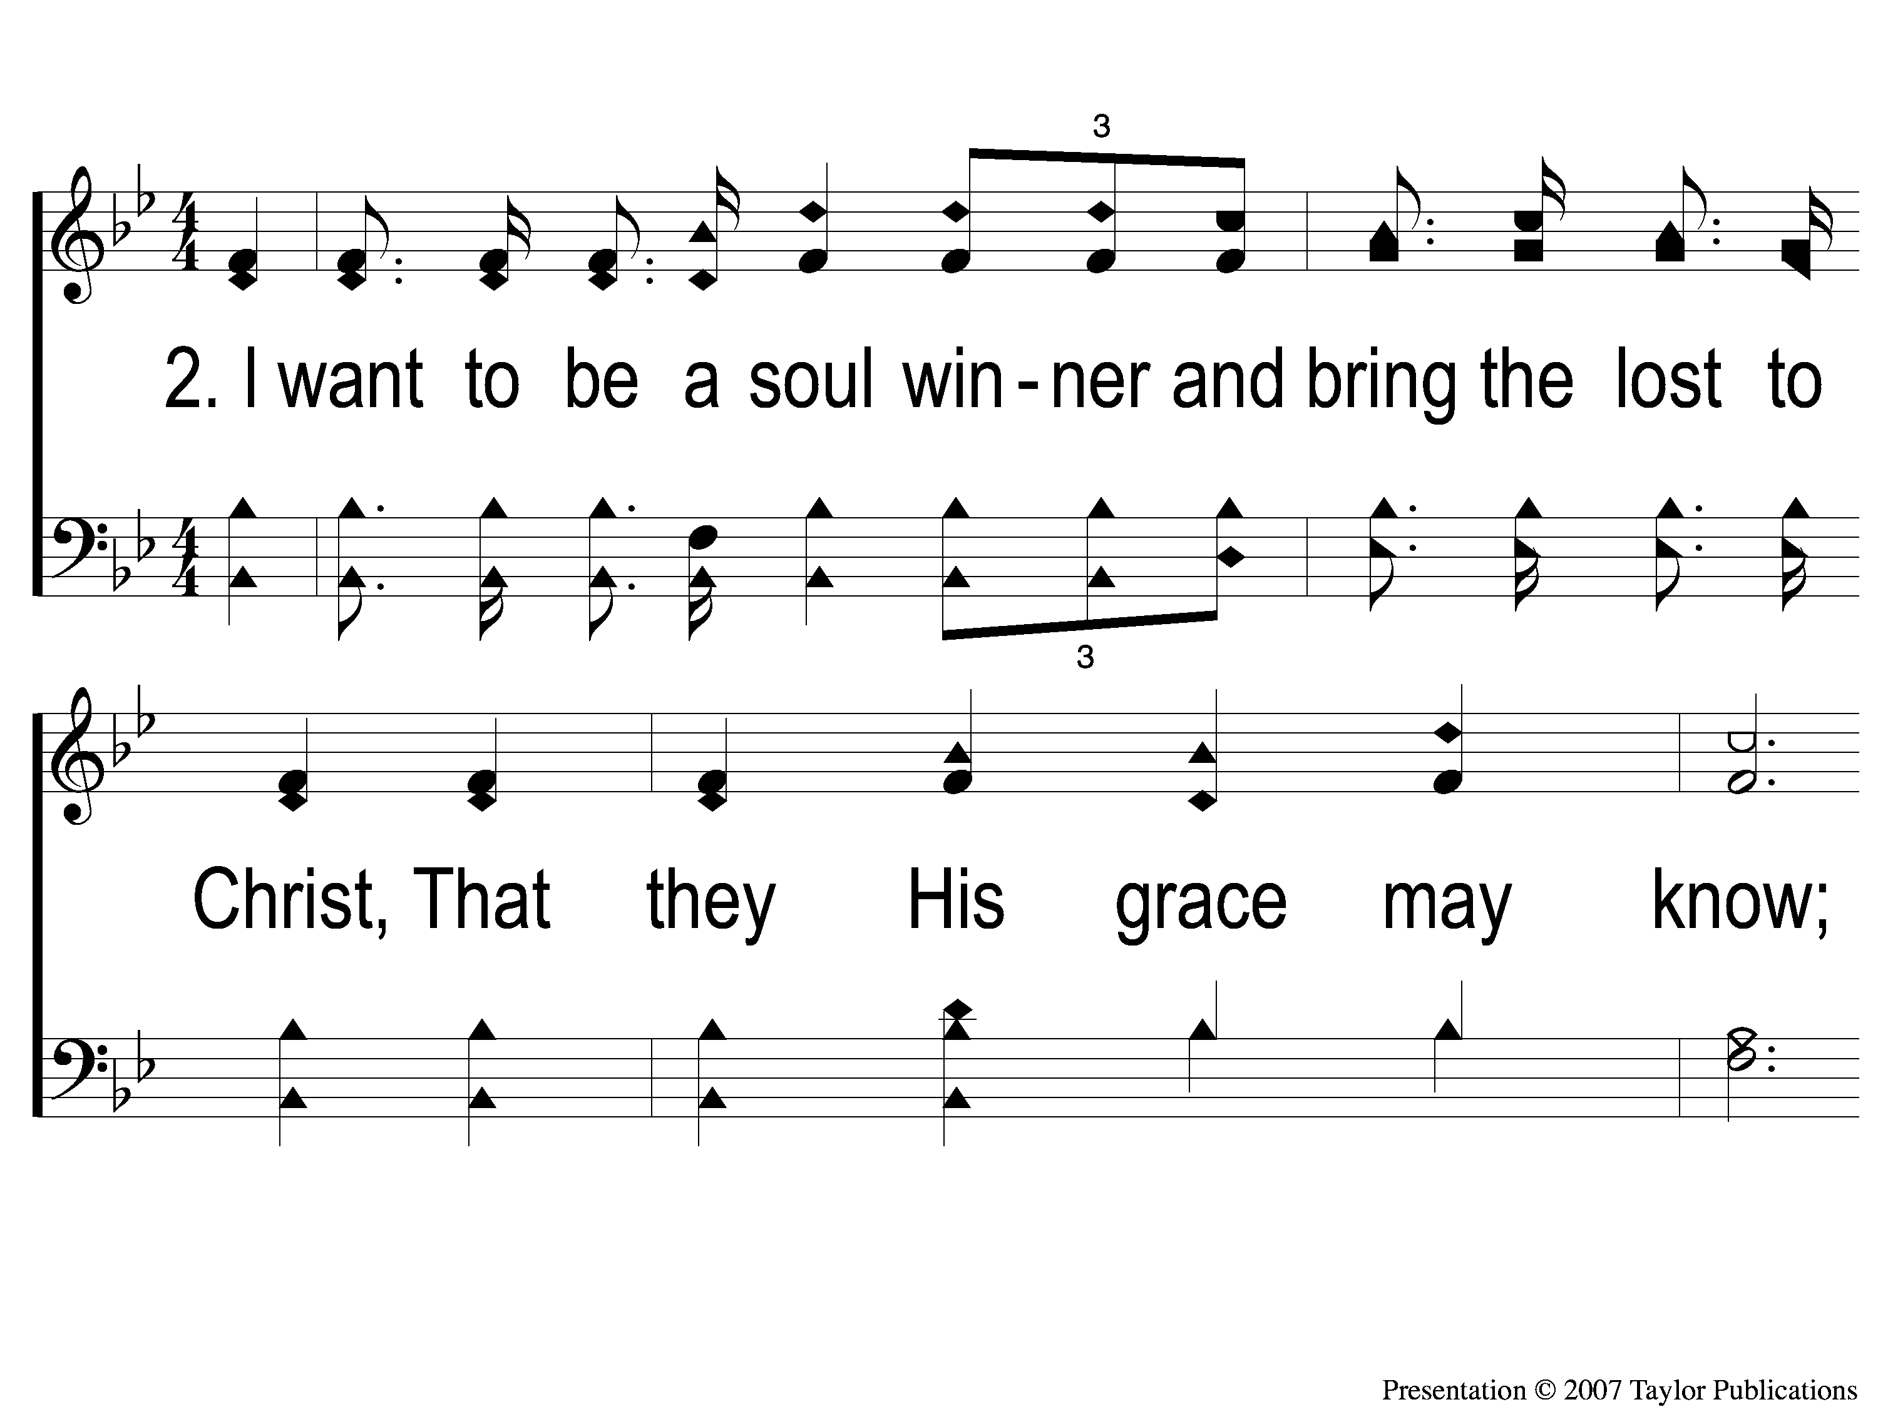
2-1 A Soul Winner For Jesus
A Soul Winner For Jesus
18

Slide 6
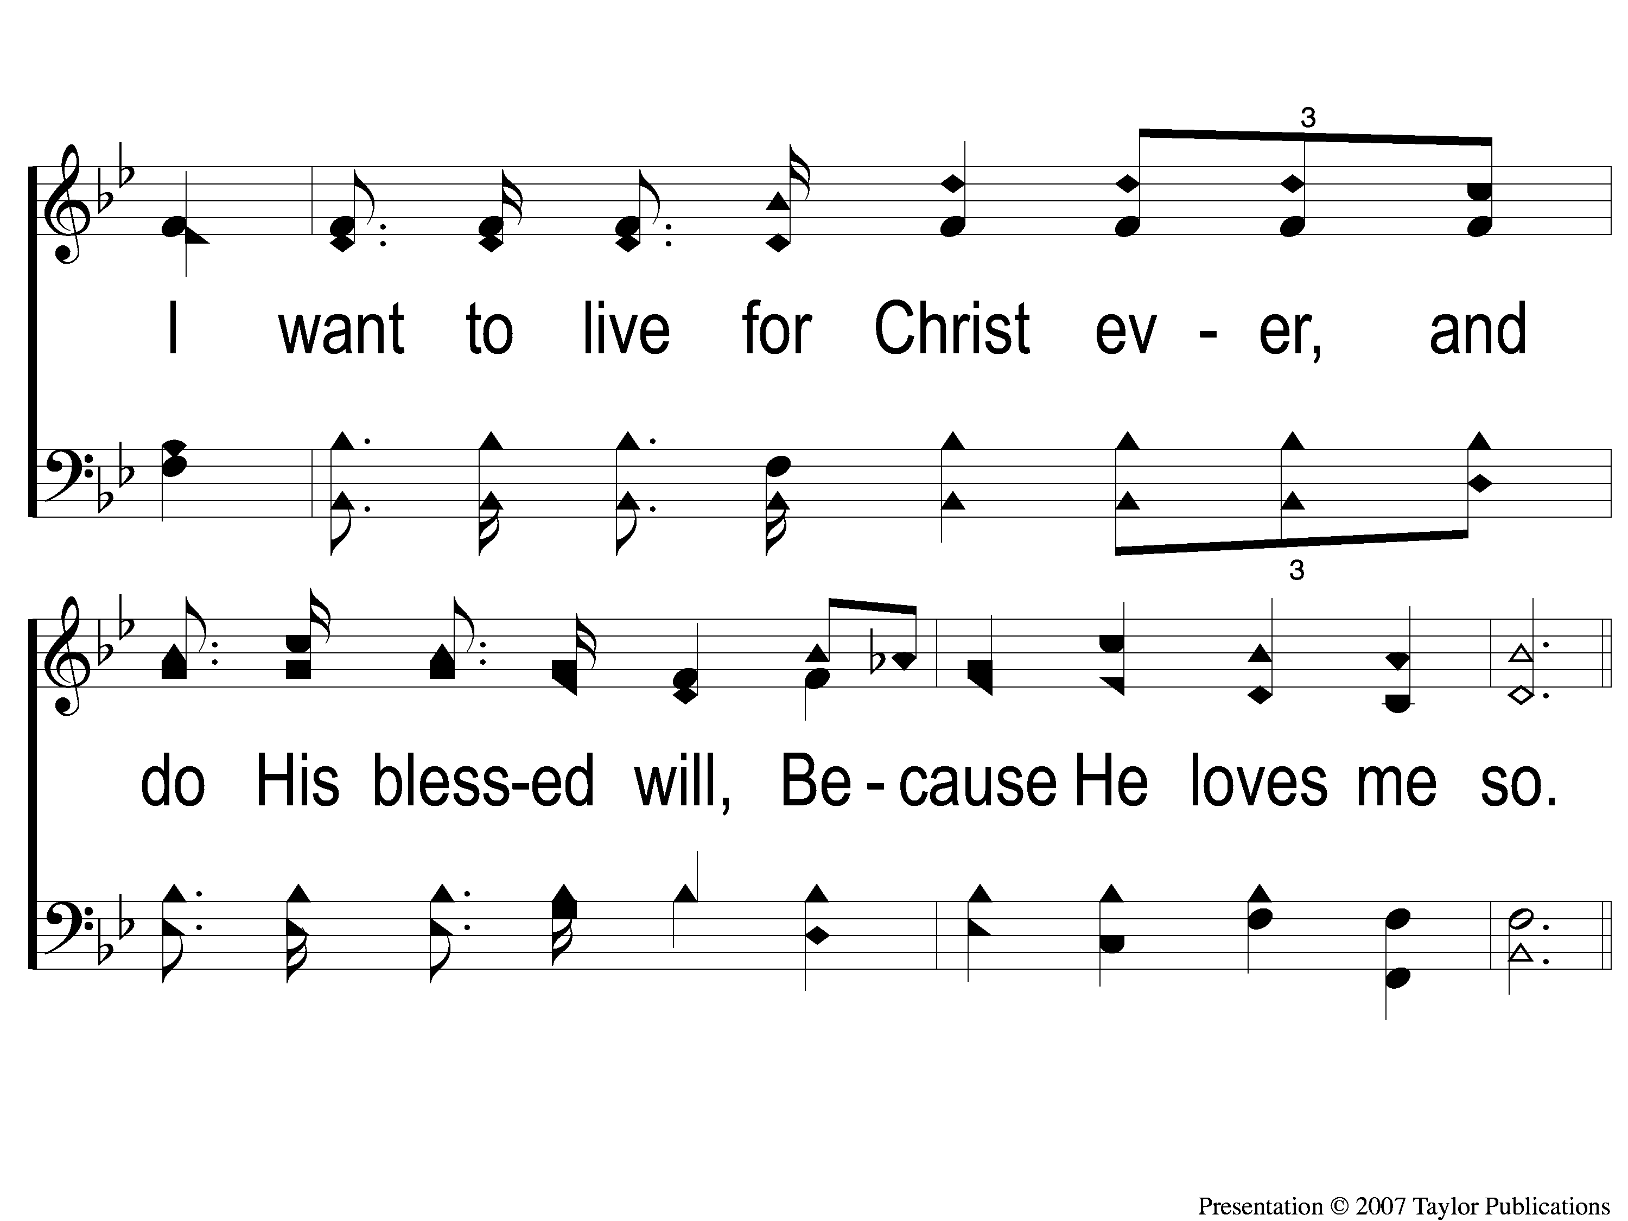
2-2 A Soul Winner For Jesus
A Soul Winner For Jesus
18

Slide 7
C-1 A Soul Winner For Jesus
A Soul Winner For Jesus
18

Slide 8
C-2 A Soul Winner For Jesus
A Soul Winner For Jesus
18

Slide 9
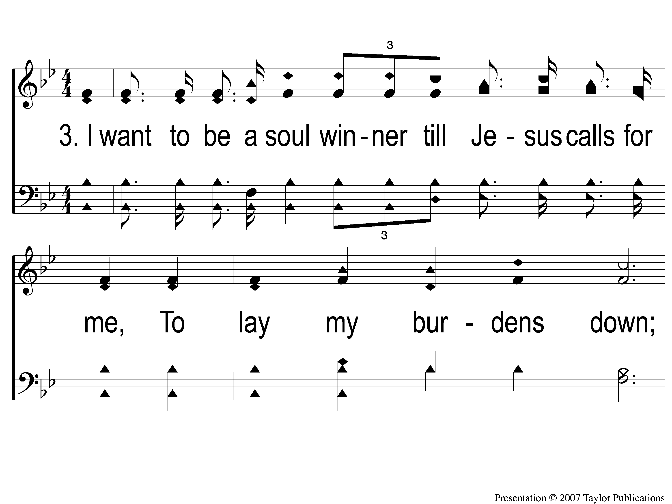
3-1 A Soul Winner For Jesus
A Soul Winner For Jesus
18

Slide 10
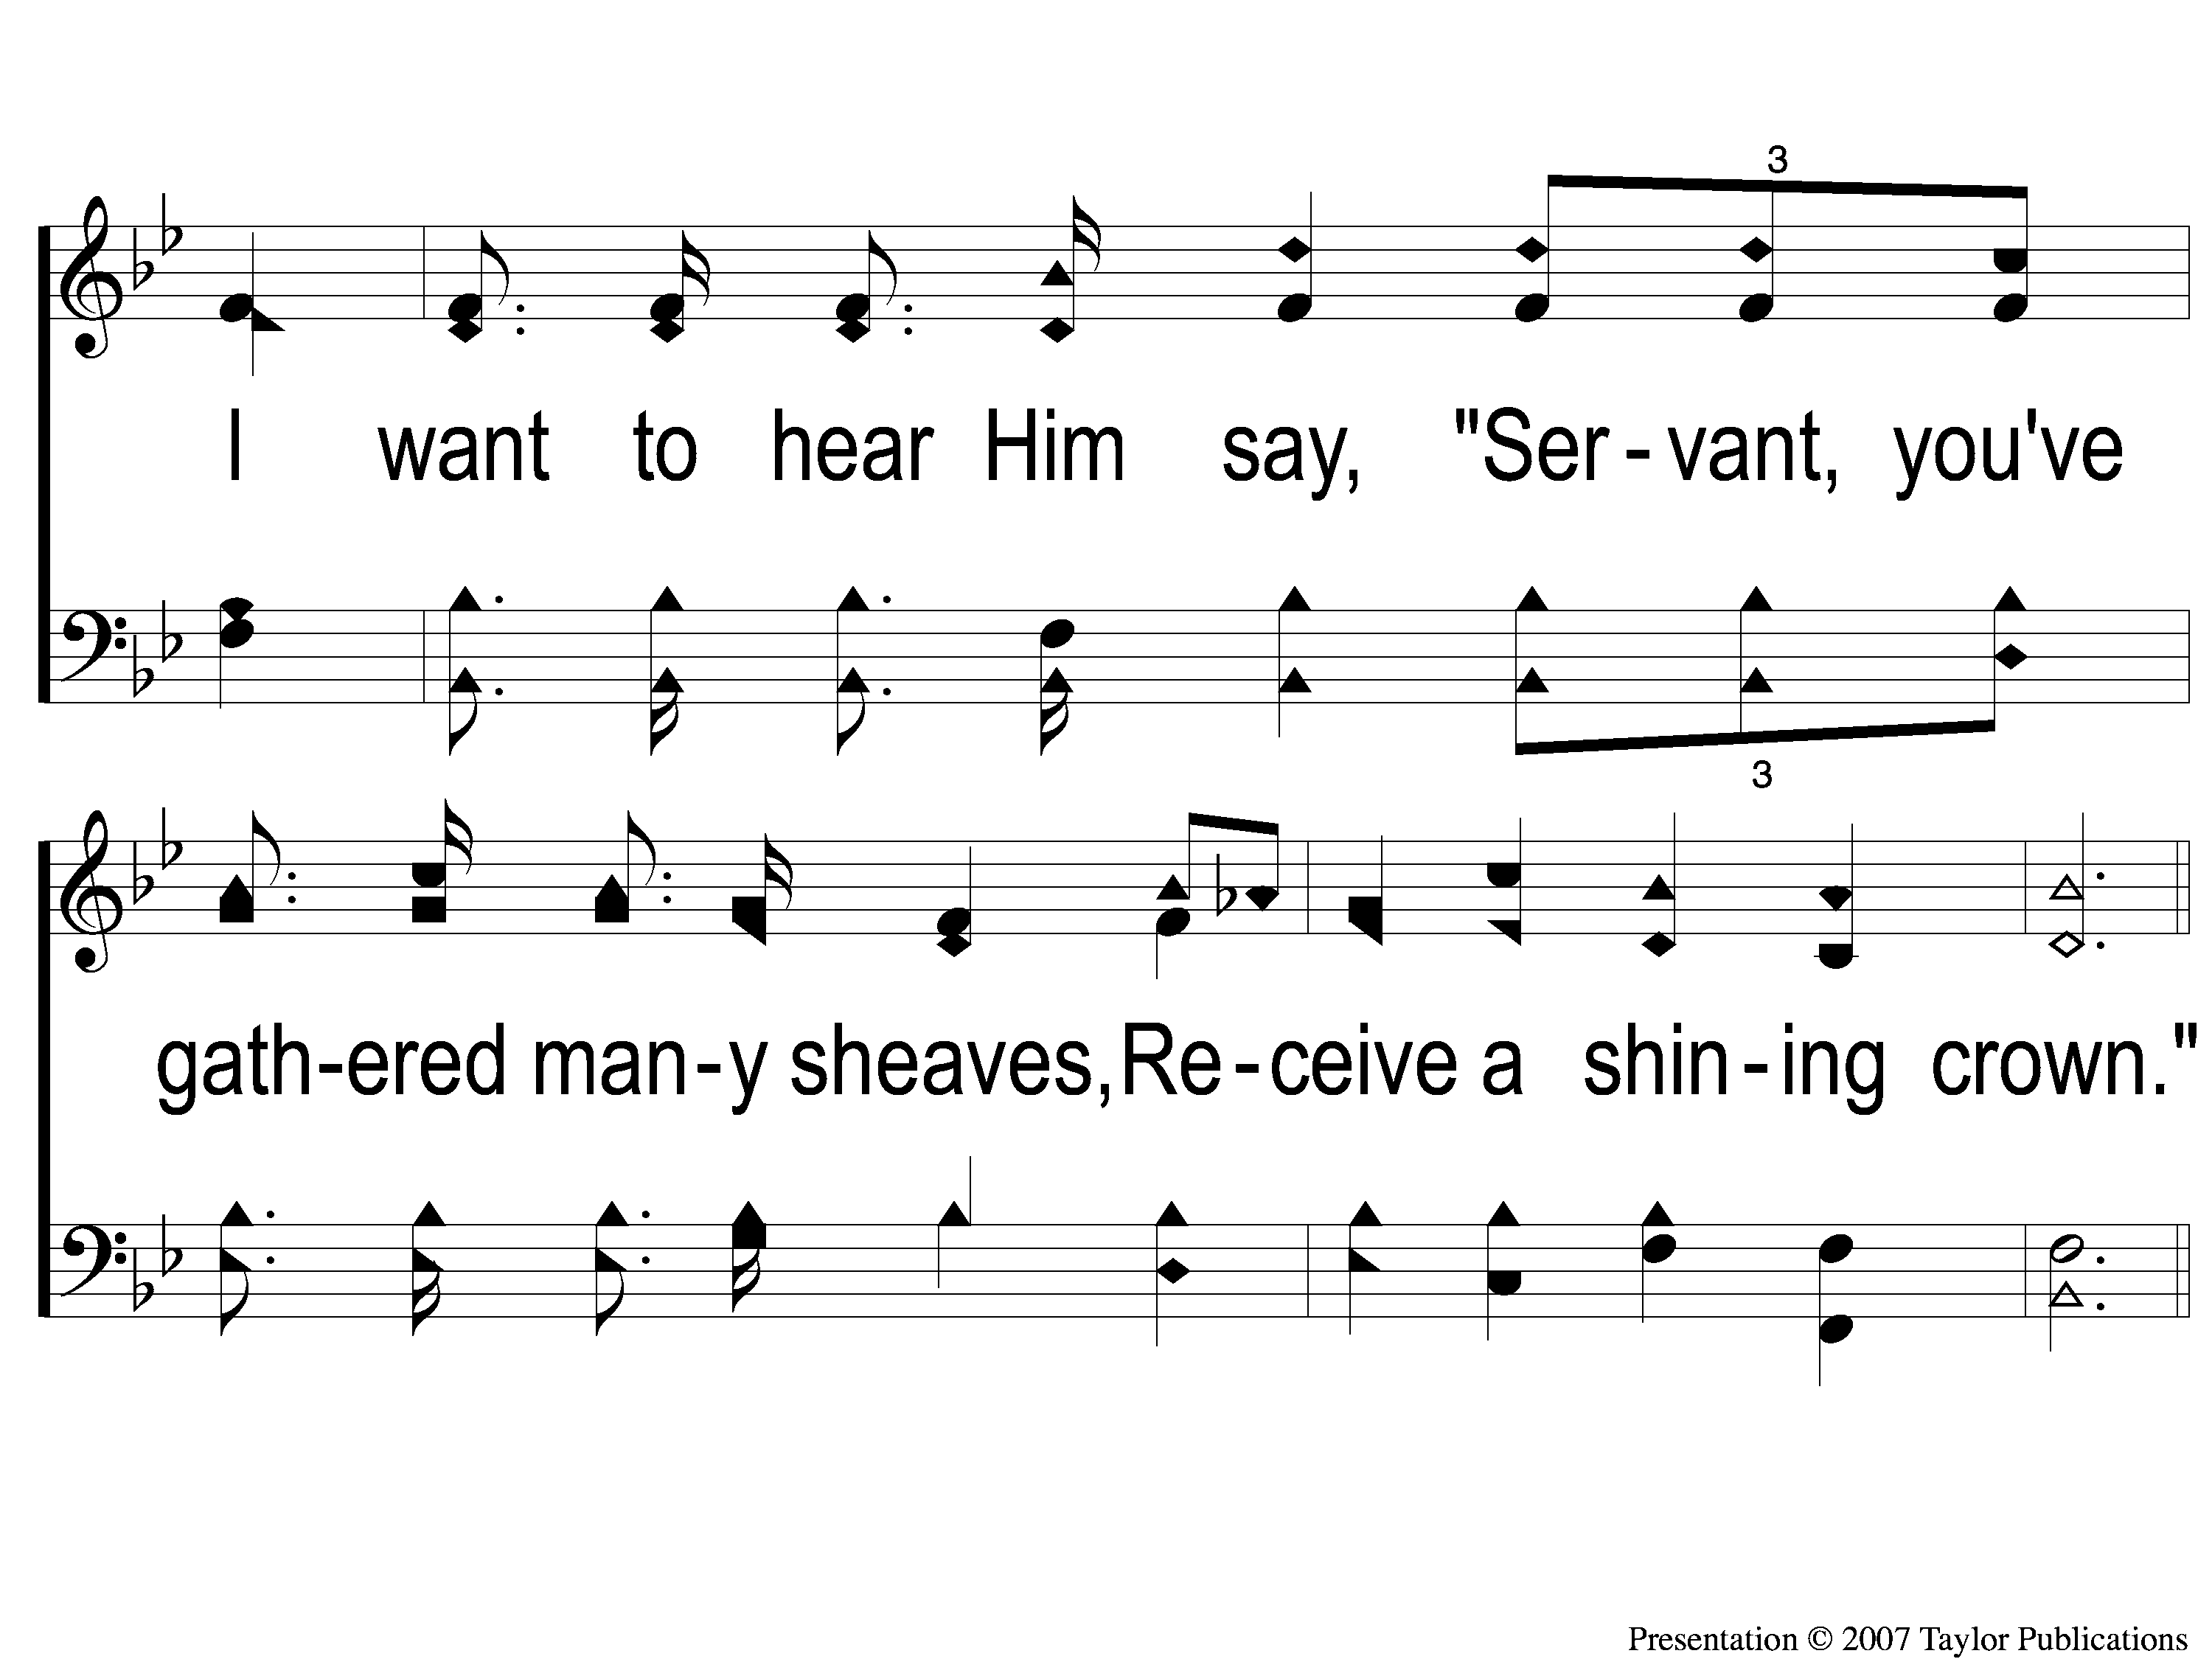
3-2 A Soul Winner For Jesus
A Soul Winner For Jesus
18

Slide 11
C-1 A Soul Winner For Jesus
A Soul Winner For Jesus
18

Slide 12
C-2 A Soul Winner For Jesus
A Soul Winner For Jesus
18

